Slide 1


Slide 2


Slide 3
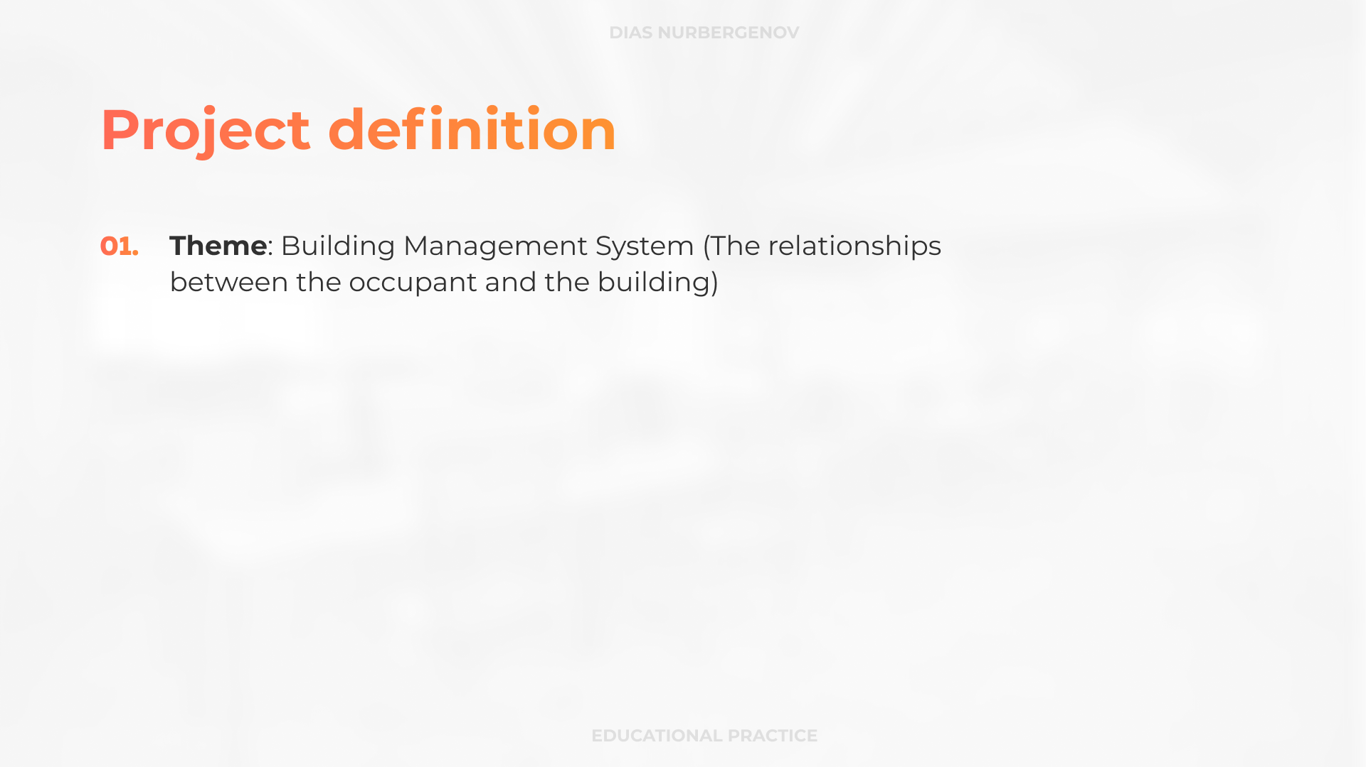

Slide 4
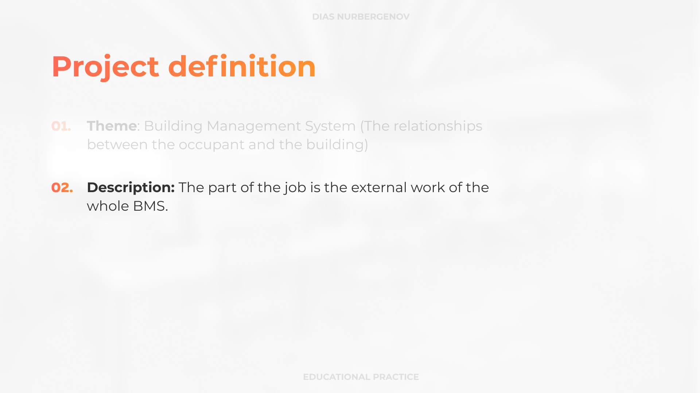

Slide 5
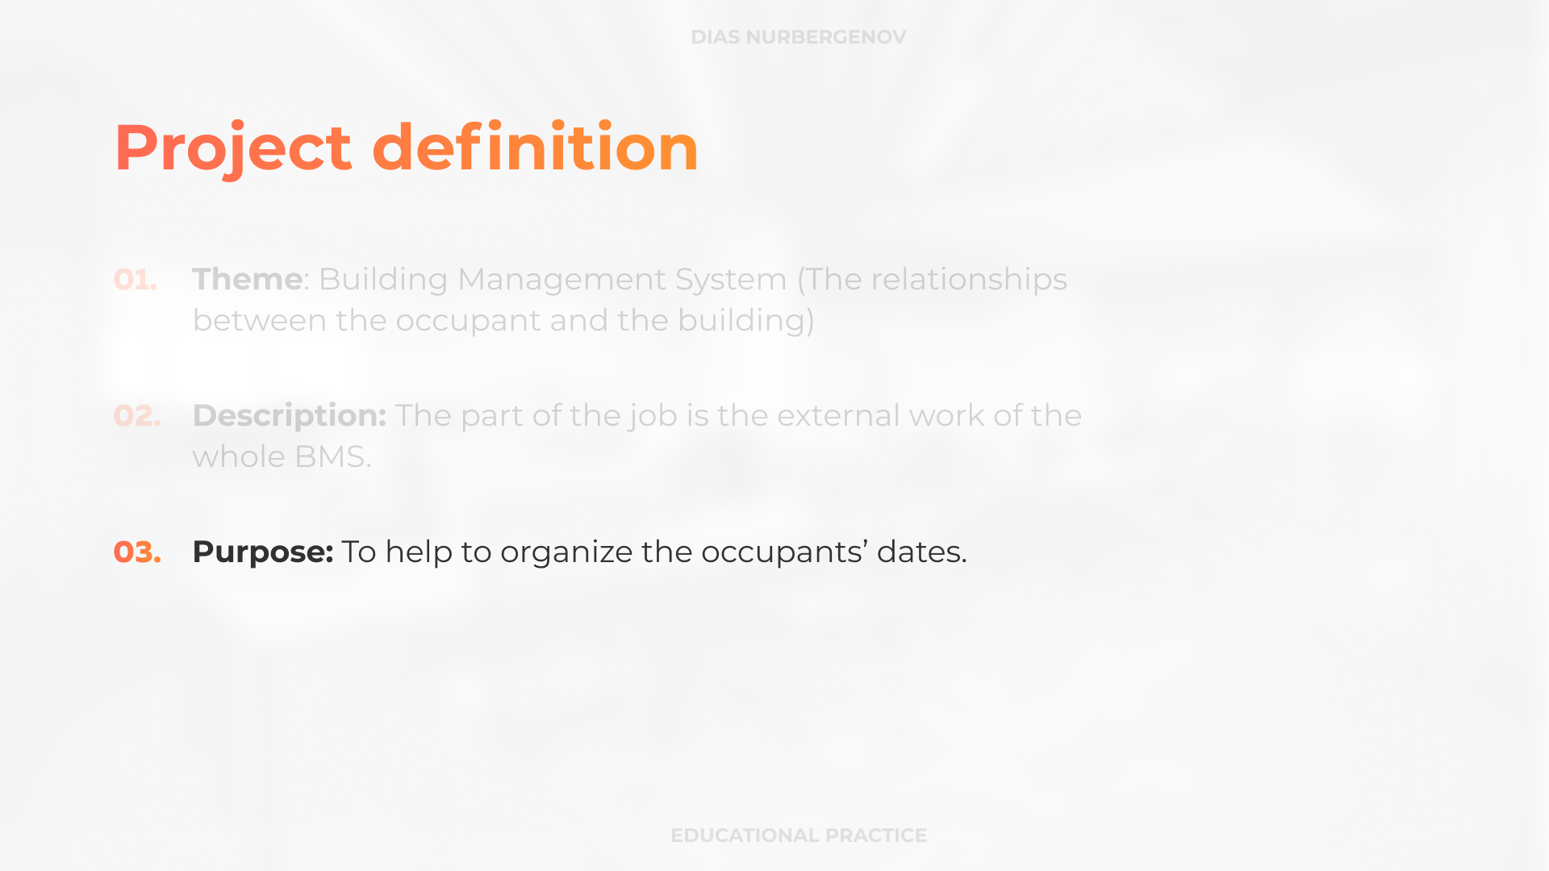

Slide 6
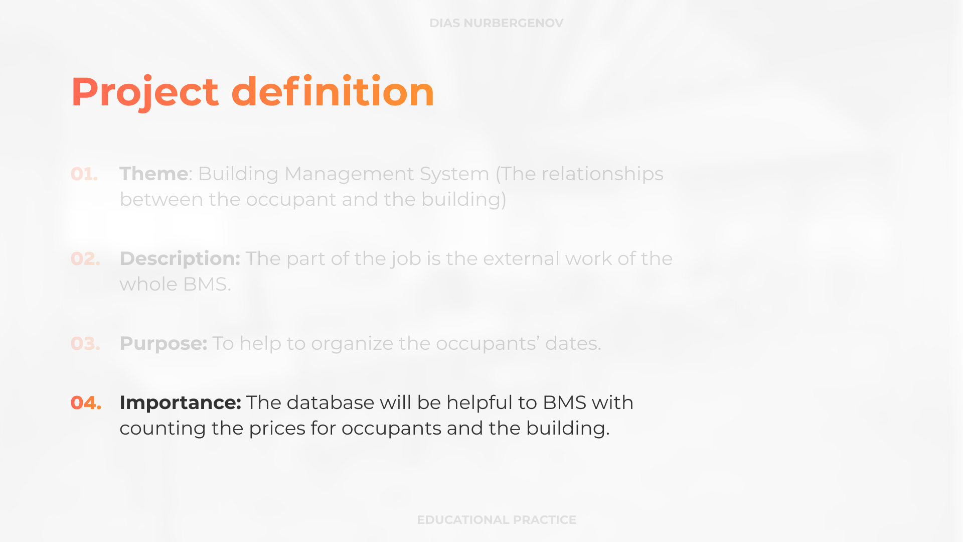

Slide 7
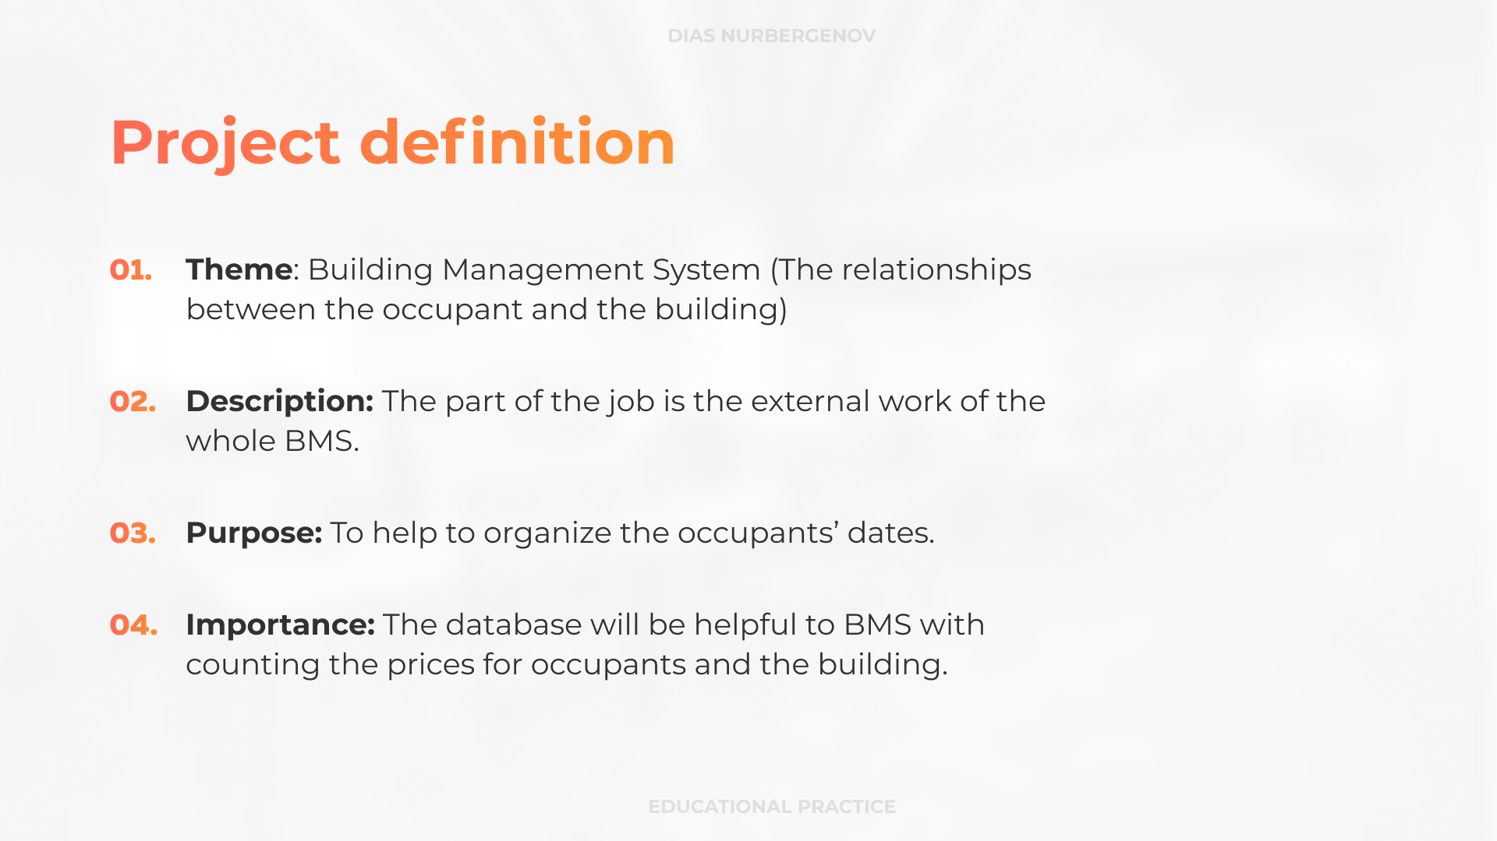

Slide 8
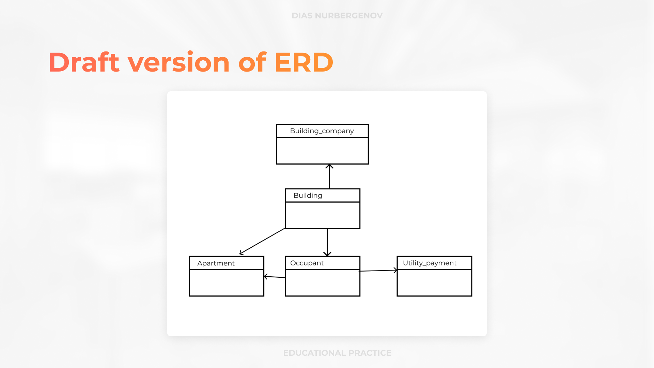

Slide 9
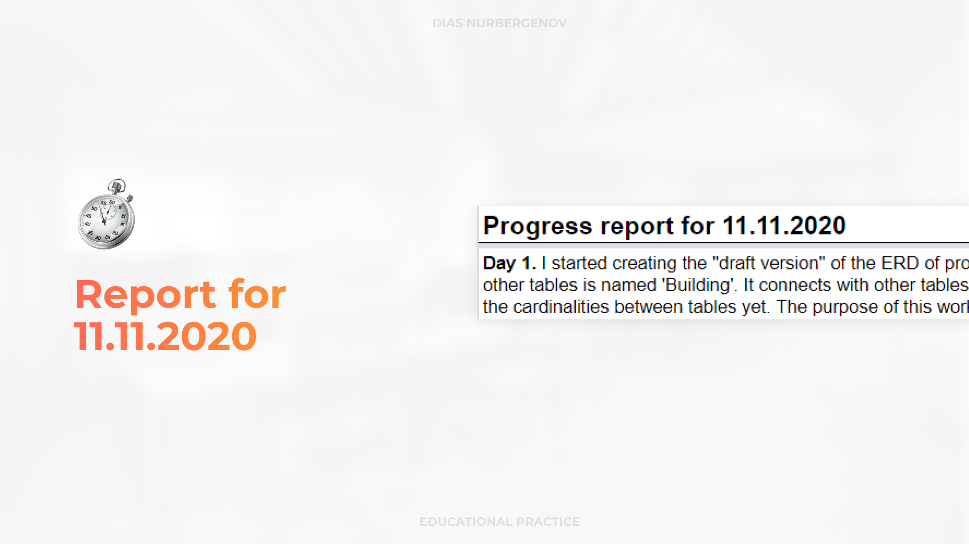

Slide 10
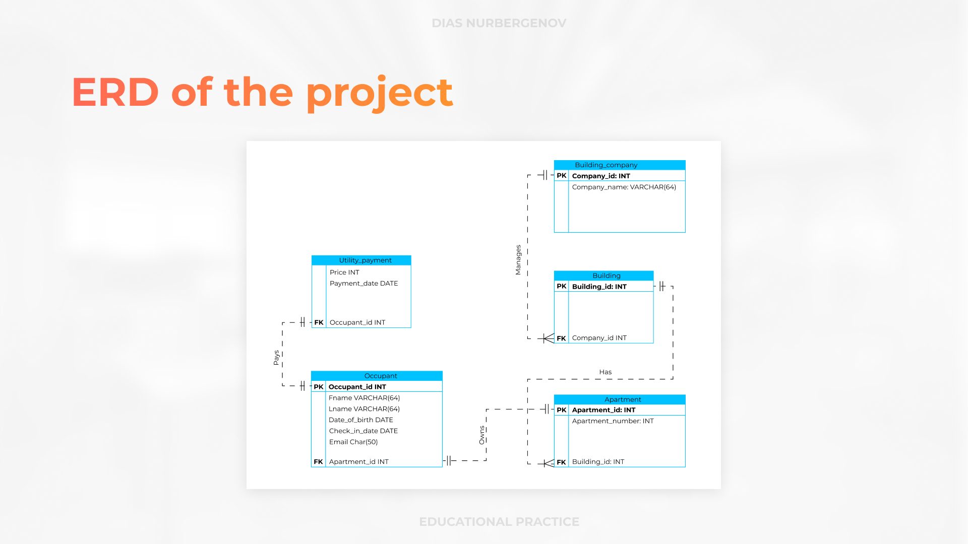

Slide 11
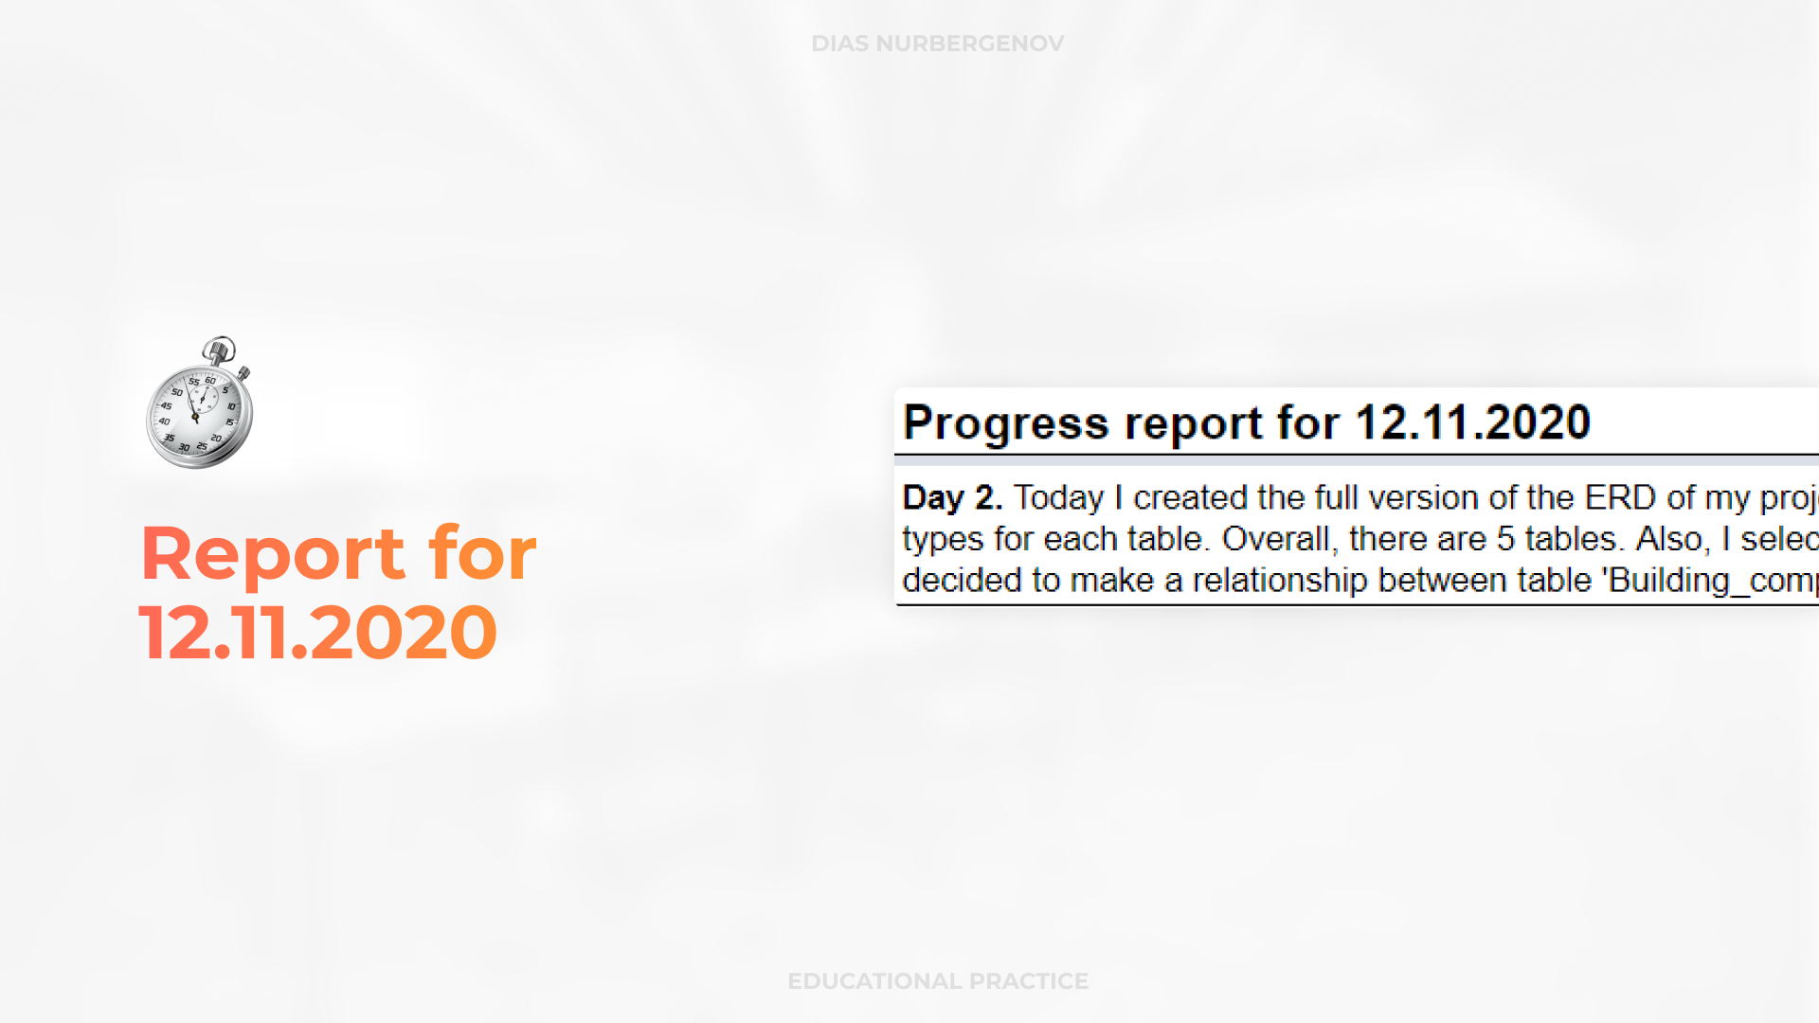

Slide 12
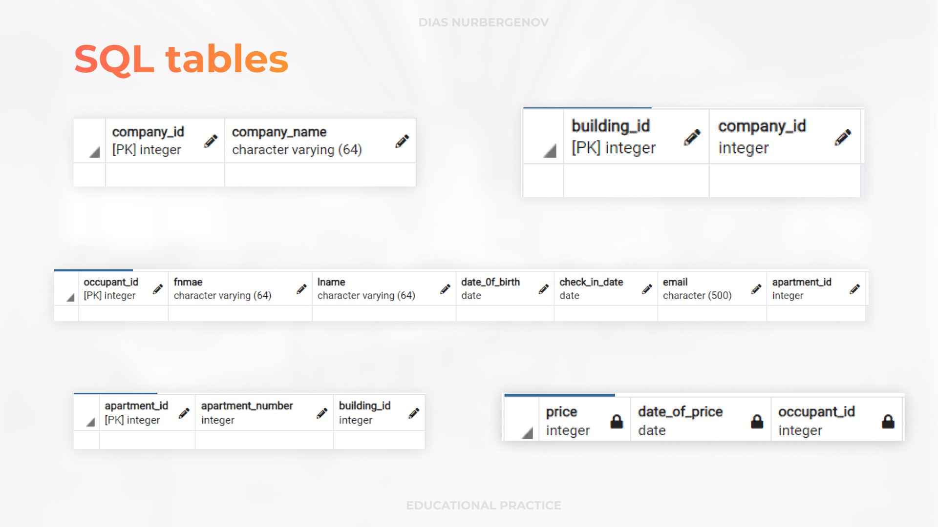

Slide 13
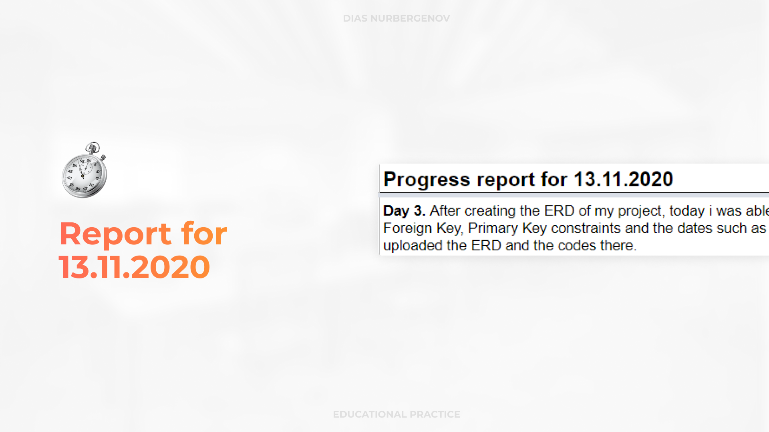

Slide 14


Slide 15
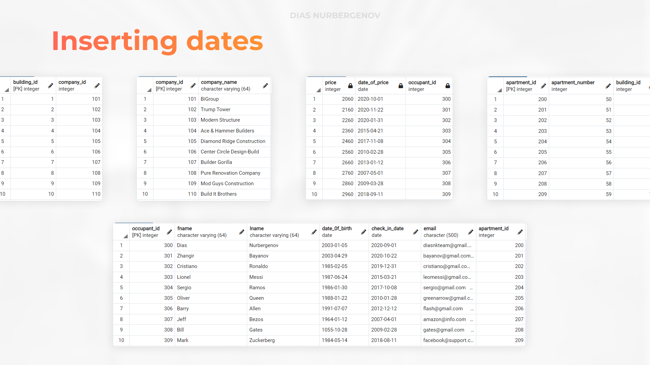

Slide 16
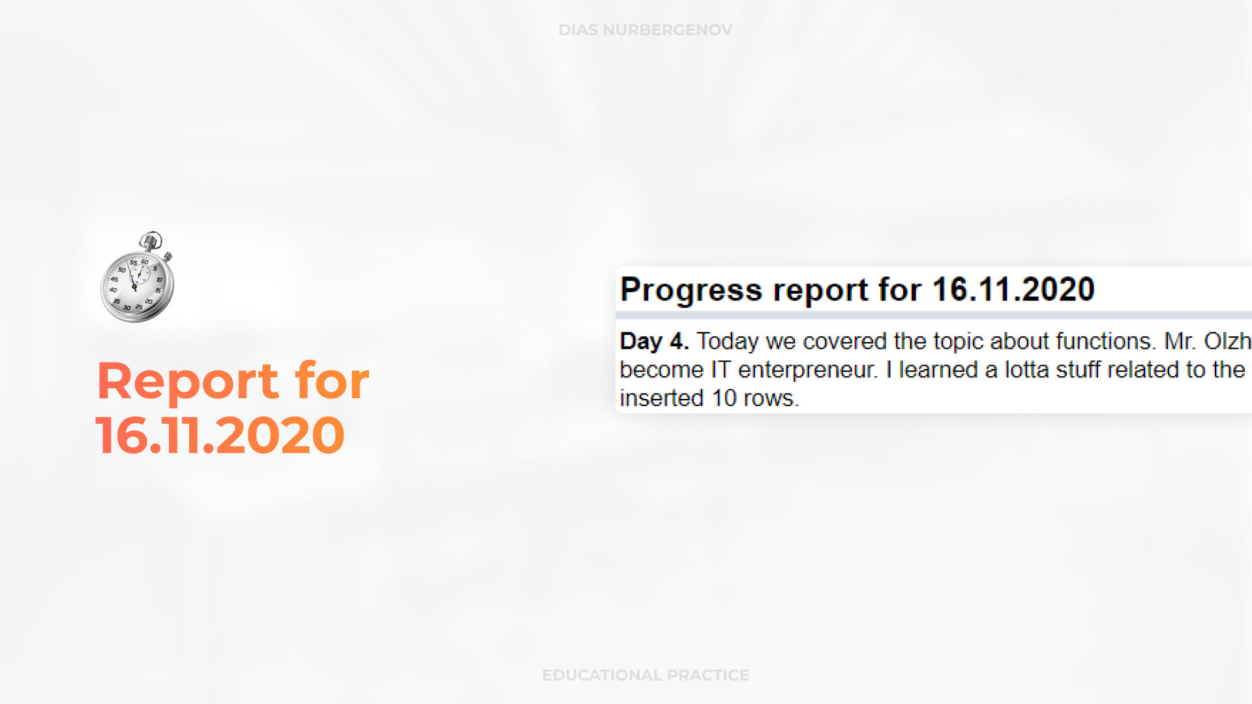

Slide 17


Slide 18
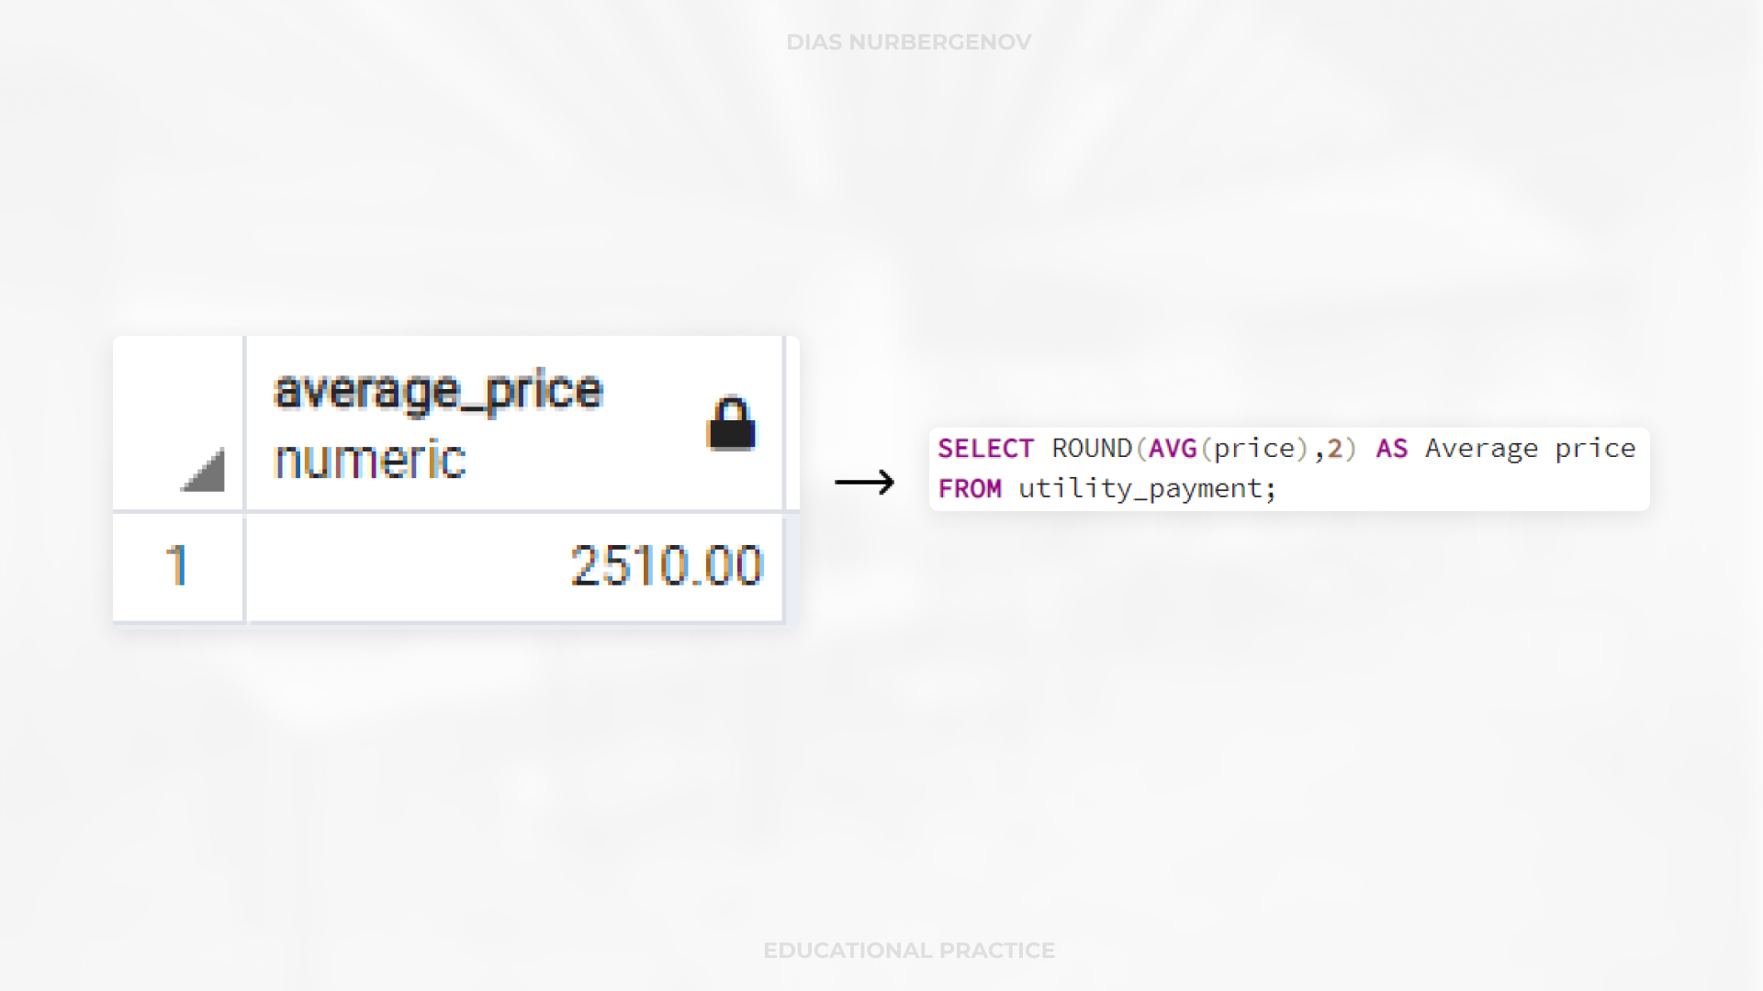

Slide 19
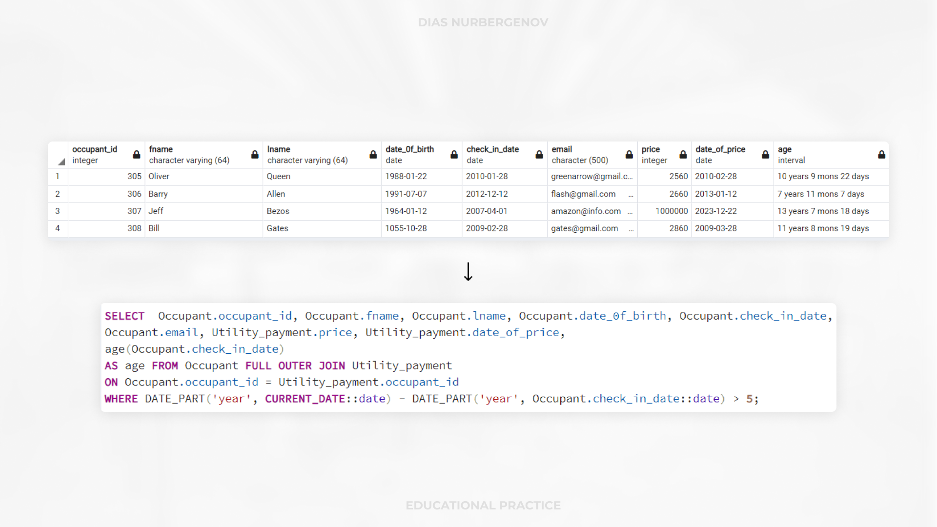

Slide 20
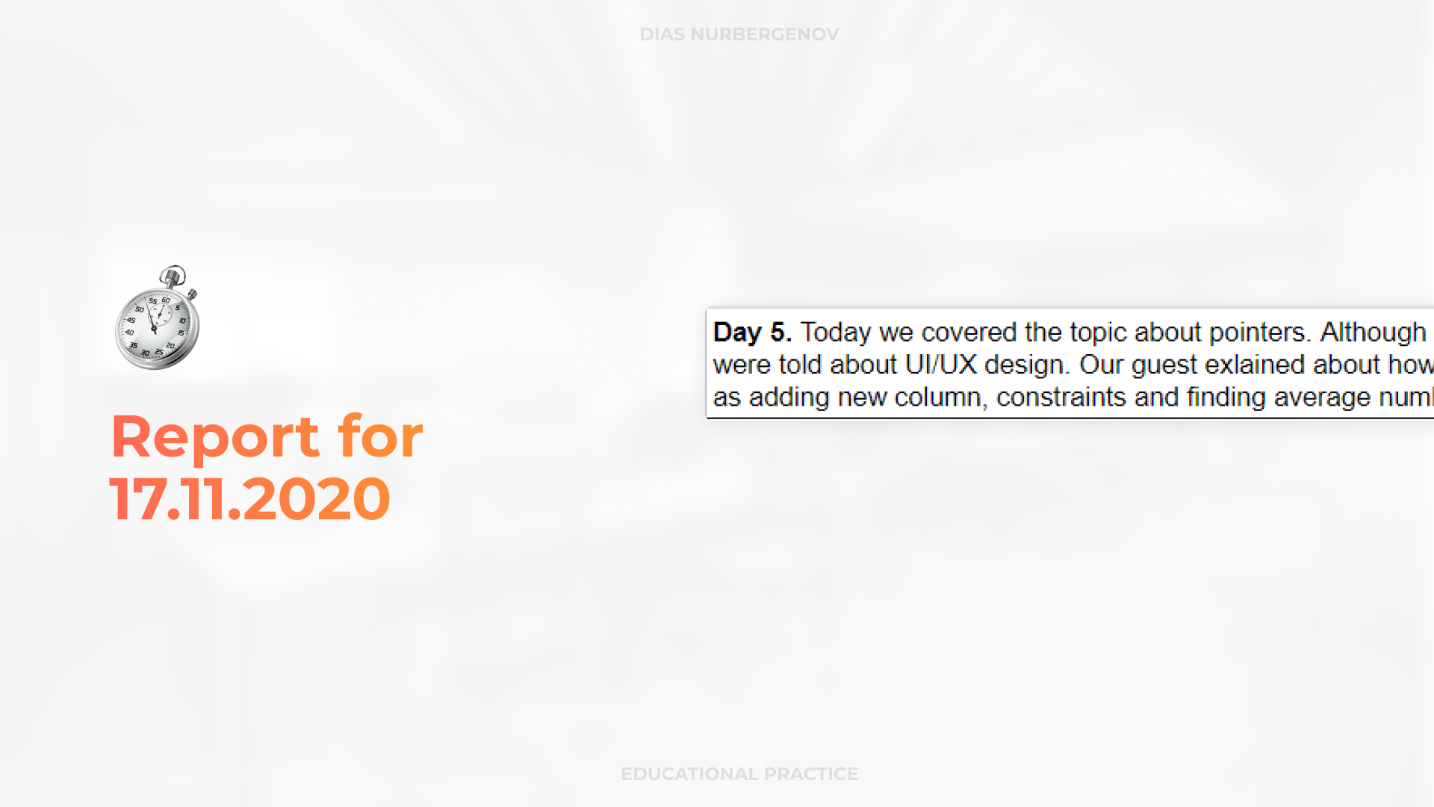

Slide 21


Slide 22
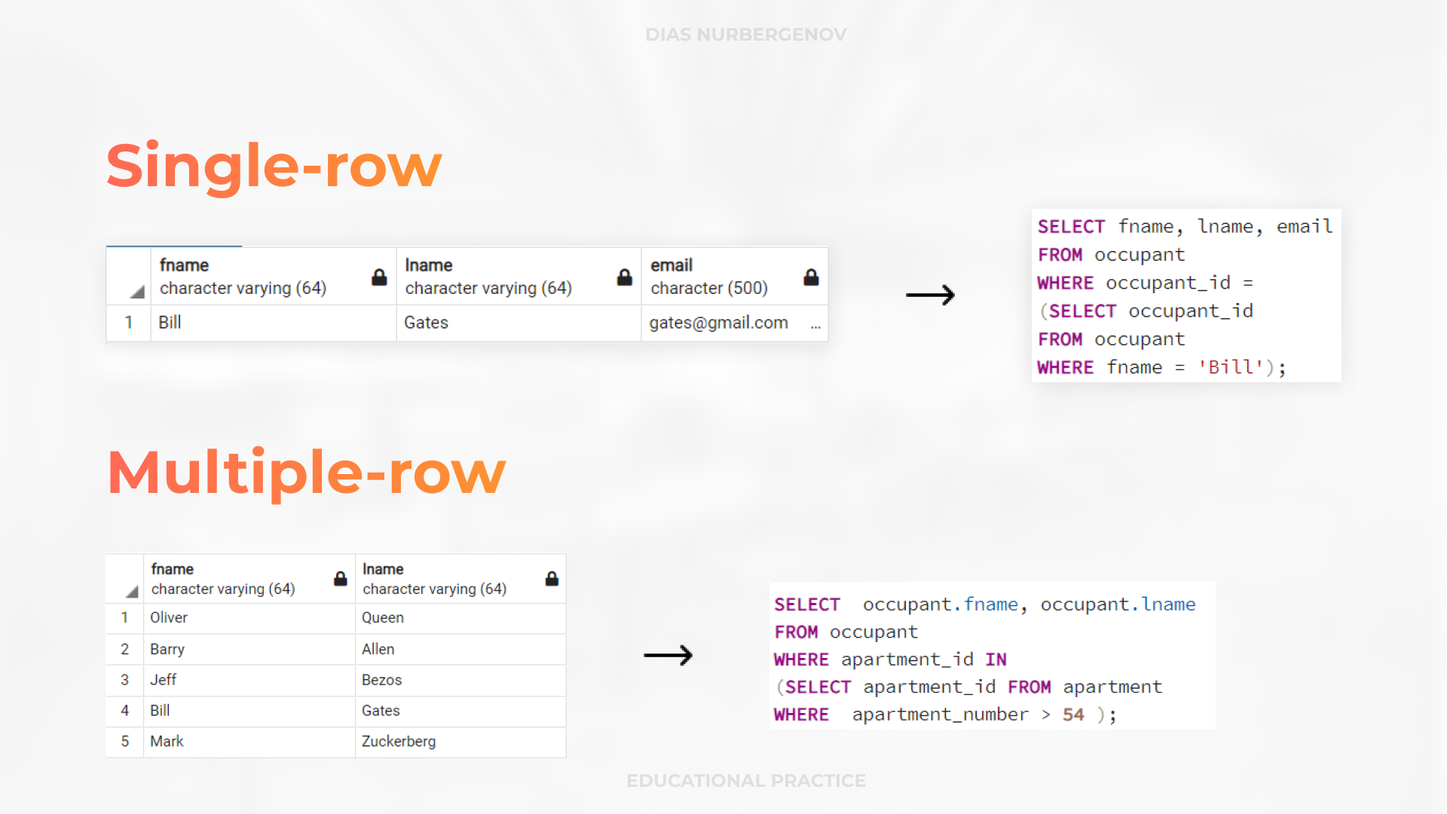

Slide 23
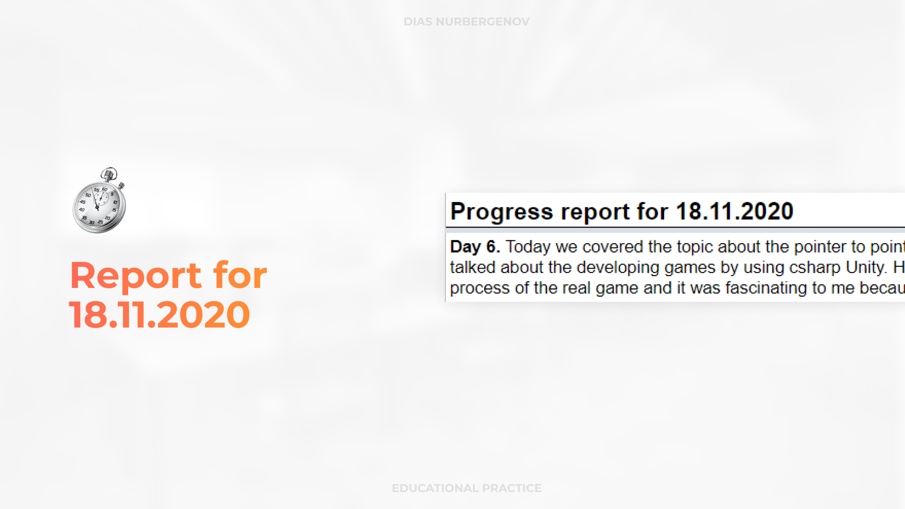

Slide 24


Slide 25
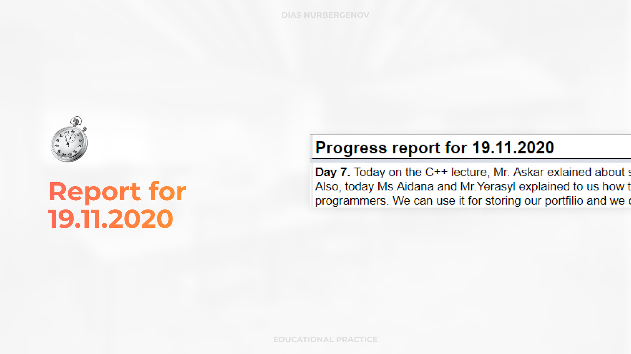

Slide 26

REFERENCES
Joseph, J., 2020. Building Management System - An Overview | Sciencedirect Topics. [online] Sciencedirect.com. Available at: https://www.sciencedirect.com/topics/engineering/building-management-system [Accessed 20 November 2020].
J.Knibbe, E., 2020. US5565855A - Building Management System - Google Patents. [online] Patents.google.com. Available at: https://patents.google.com/patent/US5565855A/en [Accessed 20 November 2020].
J.Thomas, R., A.Anderson, N., G.Donaldson, S. and A.Behar, M., 2020. US7567844B2 - Building Management System - Google Patents. [online] Patents.google.com. Available at: https://patents.google.com/patent/US7567844B2/en [Accessed 20 November 2020].
Suzuki, M. and Yagishita, M., 2020. US4918615A - Building Management System - Google Patents. [online] Patents.google.com. Available at: https://patents.google.com/patent/US4918615A/en [Accessed 20 November 2020].
JUNG, H., YOUN, S. and JEON, D., 2020. US20080195687A1 - Building Management System And Method - Google Patents. [online] Patents.google.com. Available at: https://patents.google.com/patent/US20080195687A1/en
[Accessed 20 November 2020].

Slide 27


